Slide 1


How the ReAct Pattern Makes AI Agents Smarter
Reason + Act = Smarter Agents

Slide 2


?
?
ReAct = Reason + Act

Slide 3





Traditional LLM
ReAct Agent
One-line prompt
One-line response

Slide 4

Reason
The
ReAct
Process
Answer
Act
Think
Observe

Slide 5
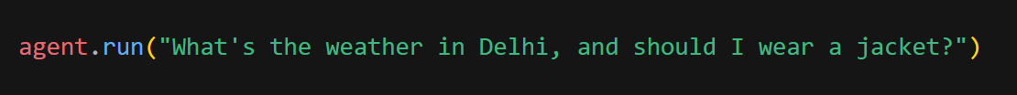



Code Example
Need current temperature.
Call the weather API.
14°C, cloudy.
Yes
Wear a jacket.

Slide 6
Why It Makes Agents Smarter

Slide 7



Why It Makes Agents Smarter
Reason
Act
Learn
Improve

Slide 8
Agent Building for Developers
~By Arshita Satpute

